Slide 1
AC6761 Artificial Intelligence Accounting
Chapter 6 Accounting Information Querying with ACCESS

Slide 2
Construct database using ACCESS

Slide 3
Microsoft Access
When you start a new database, Access automatically opens a new table for you, which is opened in datasheet view.
Datasheet view assumes you want to create table simply by entering data. In contrast, design view gives you control over all choices that need to be made during table creation, such as specifying data types and field properties for each attribute in the table.
A data type or field property determines what kind of data values may be entered into a database table’s column. Examples include text, numbers, currency, date/time, etc.

Slide 4
Microsoft Access
Change the datasheet view to design view by clicking on the View icon near the top left corner of the Table Tools window and then click on Design View.

Slide 5
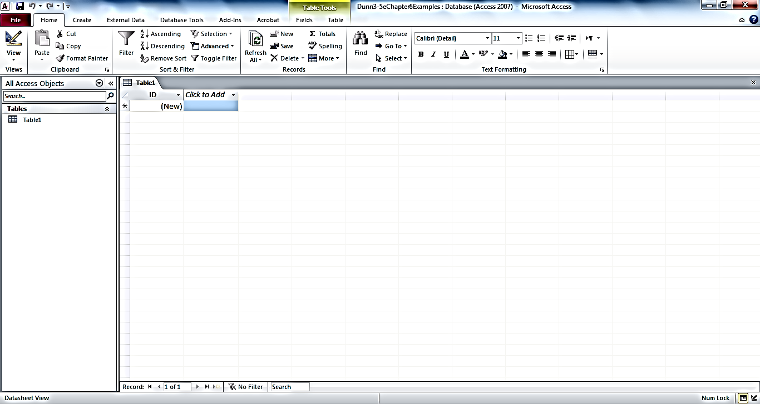
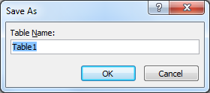
Table Tools
When you create a blank database, Access assumes you want to create a table in datasheet view, and it assigns Table1 as a default name for the table
To refuse the suggestion and instead create the table in design view, click on this View icon
A popup window will prompt you to save the table before switching to design view; we’ll name the table Sale

Slide 6
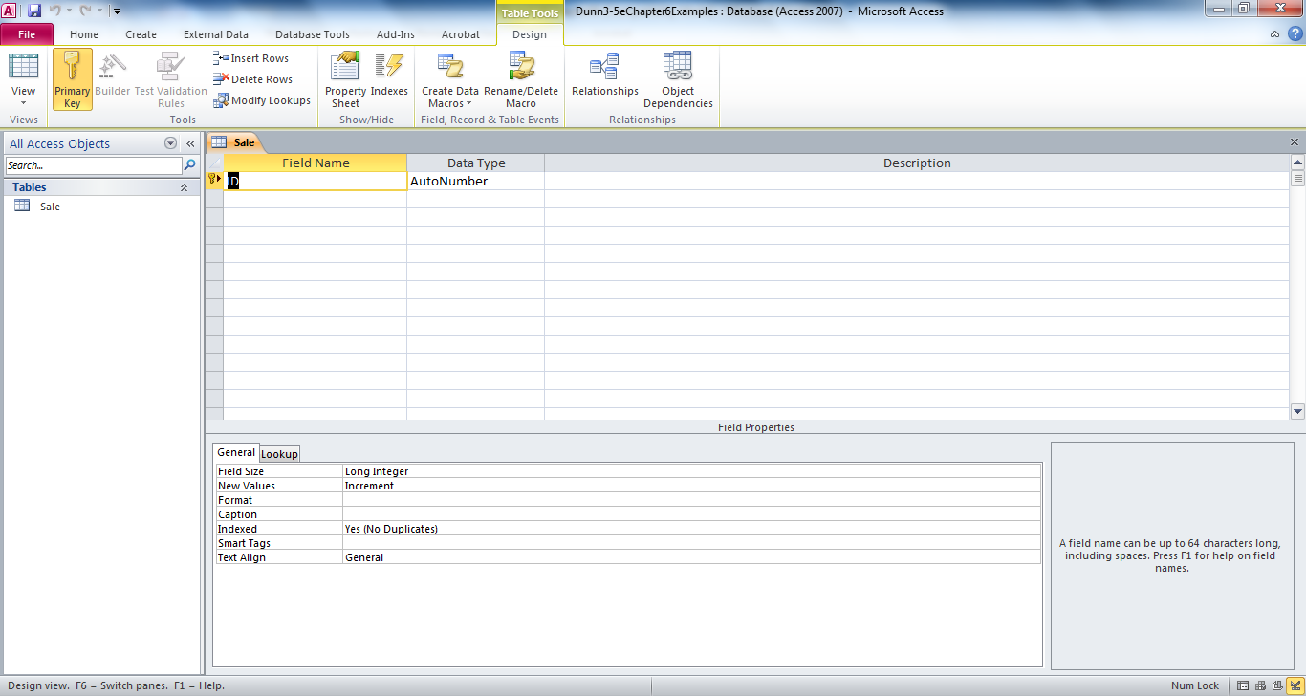
Microsoft Access Table Design View
Section 1: table design grid
Section 2: field properties panel

Slide 7
Microsoft Access
Section 1 shows the overall layout of the table.
The attributes/fields of the table are listed on the left.
The appropriate data type for each attribute could be chosen in the middle column (e.g. text, currency, date, number, etc).
The description of attribute is provided in the right-hand column (maybe left blank).

Slide 8
Microsoft Access
In section 2, additional properties for each field should be set, such as field size, customized format, default value, validation rules, or a specification as to whether the field is required to contain data (or whether it’s ok to have null values).

Slide 9
Example 1
SaleID | Date | Amount | Salesperson
061401A | 6/14 | $4,218 | 123456
061401B | 6/14 | $6,437 | 654321
061501A | 6/15 | $1,112 | 654321
061501B | 6/15 | $3,300
061501C | 6/15 | $1,776
SalespersonID | Name | Telephone
123456 | Fred | 555-0063
654321 | Francis | 555-0007

Slide 10
Example 1
Enter the four fields (SaleID, Date, Amount, and Salesperson) in the leftmost column and change each data type to its appropriate value.
A rule of thumb: if the data type is not a date, and you do not need to be able to perform calculations with it, then set the data type as text; if you do need to perform calculations with it, then set the data type as number, unless it is a dollar value in which case you should set it as currency.

Slide 11
Example 1
SaleID – text
Date – Date/Time (change the name from Date to SaleDate because date is a reserved word).
Amount – Currency
Salesperson – text

Slide 12
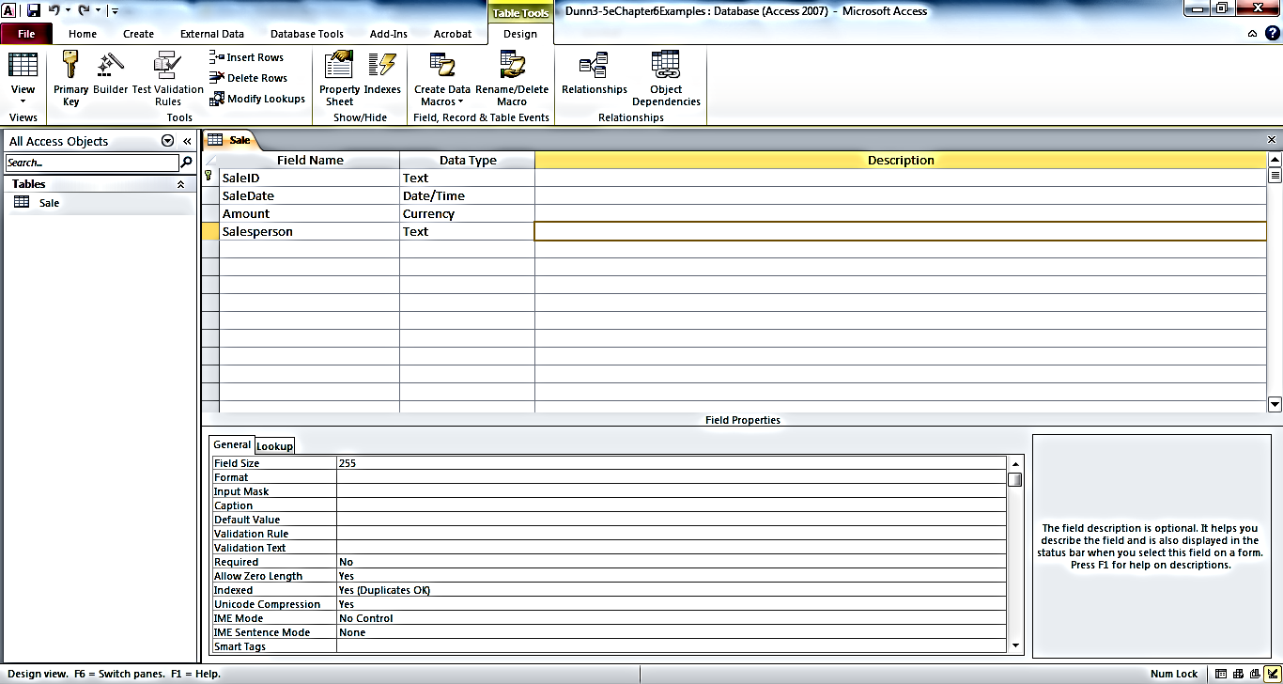
Example Sale table design

Slide 13
Field properties
Note: if the properties of two fields are different, then Access considers the values in those fields to be different even if the content is the same.
Recall referential integrity principle – for a data value entered in the Salesperson filed in the Sale table as a foreign key to be acceptable, it must either be null or it must match exactly a data value in the SalespersonID field in the Salesperson table.
The data type or field property are part of the value of the data.

Slide 14
Primary Key
The small key symbol at the gray box immediately to the left of SaleID represents primary key attribute.
If you deleted the first line and added SaleID as a new field, you may not have a key icon.
Click on the small grey box to the immediate left of the field and then click on the Primary key icon near the top left corner of the TableTools window.

Slide 15
Save
File – Save
Close.

Slide 16
Create Salesperson table
Create – Table design
Enter three fields: SalespersonID, SalespersonName, SalespersonTelephoneNumber.
Do not change the data type or any field properties.
Set SalespersonID as the primary key.
Save the table as “Salesperson”.
Close.

Slide 17
Save
File – Save
Close.

Slide 18
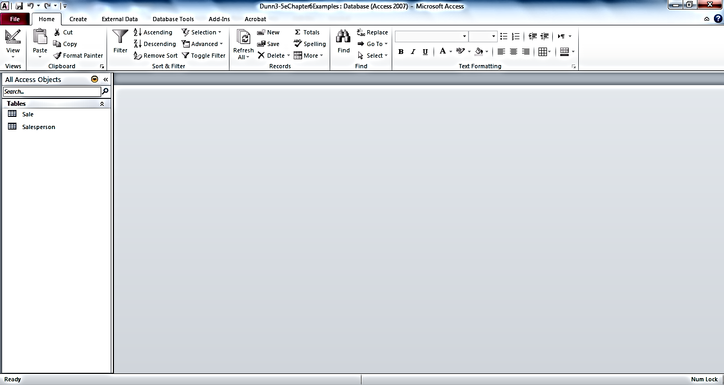
Database window after designing Sale and Salesperson tables

Slide 19
Link between tables
The way to communicate foreign keys (and concatenated primary keys that are formed from posting two different class’ primary keys into an association table) to Access is by establishing a relationship between the two tables.
Go to the “relationship layout”
Database Tools and then click on the icon labeled Relationships.

Slide 20
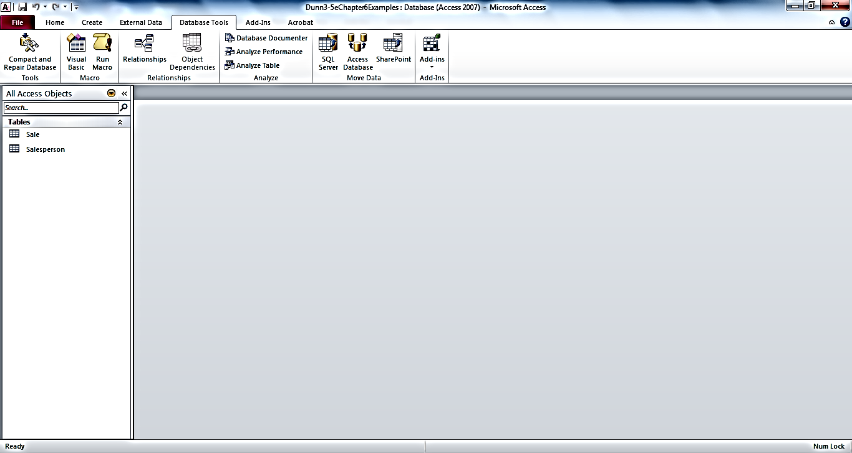
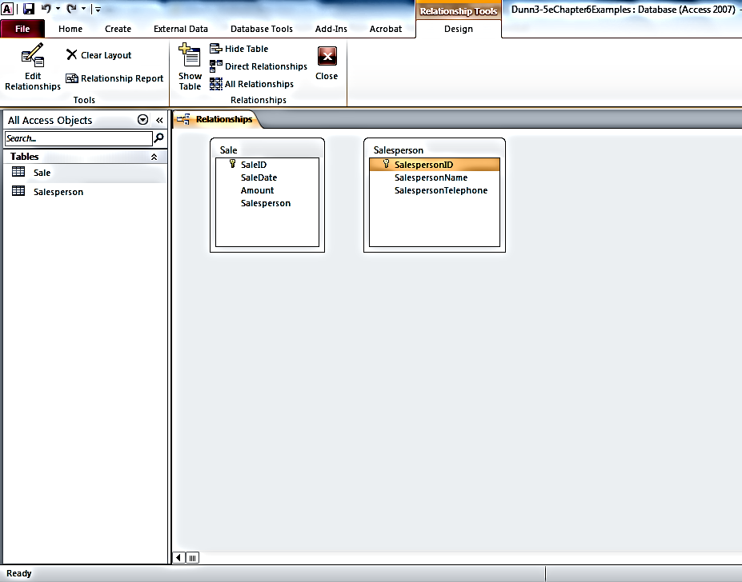
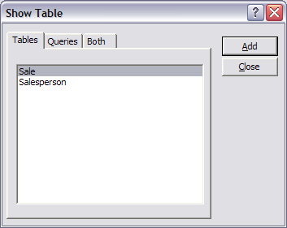
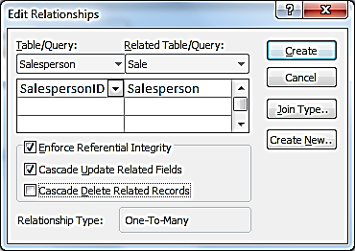
Connecting Access Tables
First, click here (on SalespersonID)
Then,drag to the matching attribute (Salesperson)
Click to enforce
Click to enable

Slide 21
Link between tables
Show Table window
Highlight both tables and add them to the layout, and then close Show Table window
Click on SalespersonID in Salesperson table and drag to the matching attribute in Sale table.
“Edit Relationships” window shows.
Allow you to enforce referential integrity
Cascade updated related fields – if you change the value of a primary key such as SalespersonID then you want the corresponding posted foreign key values to also be changed, such as the Salesperson values in the Sale table.

Slide 22
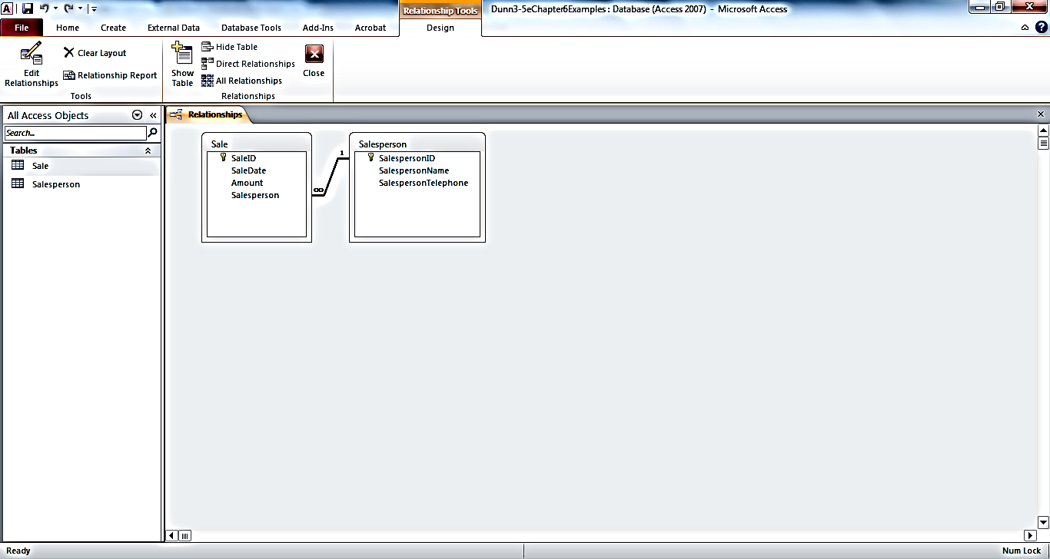
Connected Tables

Slide 23
Link between tables
The 1 and ∞ symbols on the Relationship Layout seem to be multiplicities, but they are not exactly the same concept.
It resembles how many times the same data value can be stored in that field of the table to which the symbol is connected.
The same data value for SalespersonID can exist in the Salesperson table only one time; may exist multiple times in the Sale table.

Slide 24
Example 2
Takes
Student
-StudentID
-Name
-Address
Course
-CourseID
-Description
-Credits
0..*
0..*
-grade earned
Student – StudentID, Name (StudentName), Address (StudentAddress)
Course – CourseID, Description, Credits
Takes – StudentID, CourseID, Grade earned
Create a new blank database, save as Database2
Create the three tables and indicate the relationship

Slide 25
Concatenated primary key
Click on the grey box immediately to the left of StudentID. Hold the shift key and click on the grey box immediately to the left of CourseID. Click the key icon.

Slide 26
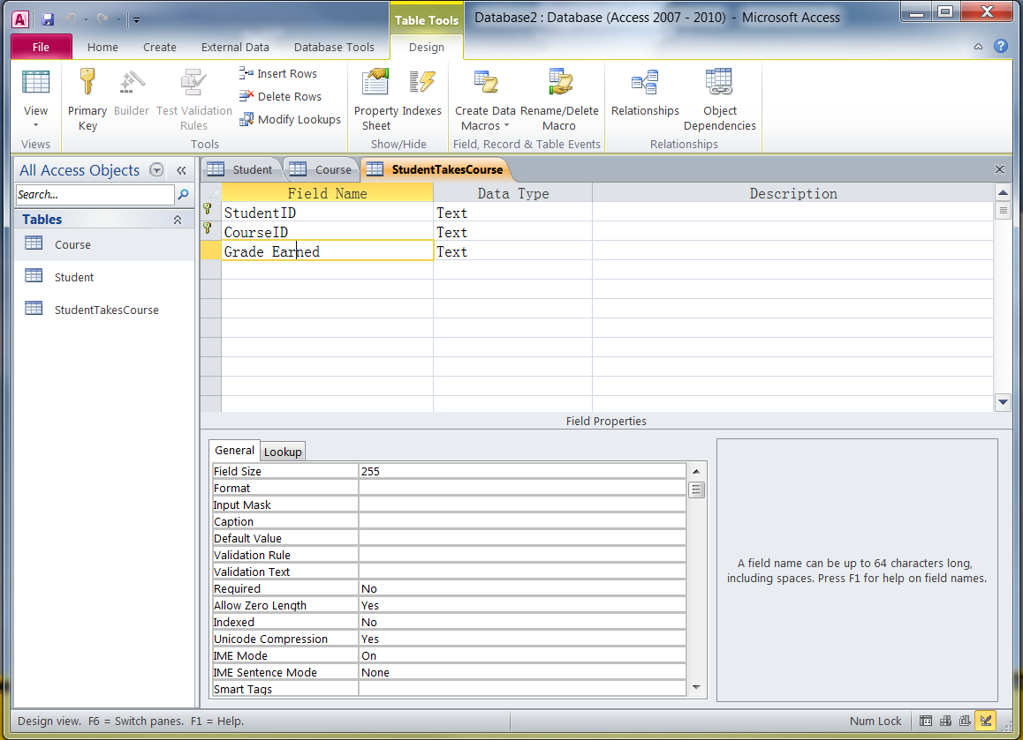

Slide 27
Relationships
Close all the tables
Database Tools – Relationships – Add all the tables – drag StudentID from Student table to StudentTakesCourse table; drag CourseID from Course table to StudentTakesCourse table.

Slide 28
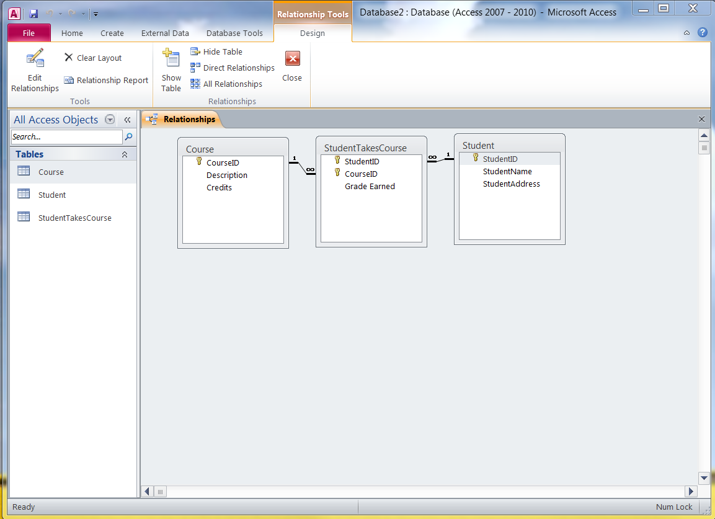
Relationships between tables versus relationships between classes

Slide 29
Information Querying using ACCESS

Slide 30
What is Querying?
It is asking questions about the data in the database and manipulating or combining the data in different ways
  We can isolate certain rows in tables, we can isolate certain columns in tables, we can join tables together, we can create calculations based on various data items, etc.

Slide 31
Three Query Languages
Relational Algebra
  Three main operators: Select, Project, Join
  Provides the conceptual basis for SQL and QBE
Structured Query Language (SQL)
  The user enters commands according to a pre-defined syntax to retrieve desired data.
Query By Example (QBE)
  The user starts with a sample of the table(s) columns and marks the fields he or she wants to include in the answer. Defaults are available for summarizing and manipulating the data.

Slide 32
Relational Algebra
Select
  includes only certain rows from a database table in its “answer”.
Project
  includes only certain columns from a database table in its “answer”
Join
  combines two or more database tables on the basis of one or more common attributes

Slide 33
Example Tables (Incomplete Enterprise Database) from Dunn & McCarthy working paper

Slide 34
Relational Algebra SELECT
Find the cash receipts from Customer #2 (keeping all the details of those cash receipts)
Select Cash Receipt Where Customer Number = C-2 Giving Answer

Slide 35
Relational Algebra PROJECT
Find the customer number, name, and salesperson number for all customers
Project Customer Over (Customer#, Name, SP#) Giving Answer

Slide 36
Join Types
Inner join
  includes only the records from both tables that have the exact same values in the fields that are joined
  I.e.,
Outer join
  includes all records from one table, and matches those records from the other table for which values in the joined fields are equal
  I.e.,
Left Outer Join
Right Outer Join

Slide 37
Relational Algebra Inner Join
Find all details of all customers and all available details of each customer’s salesperson
Join Customer, Salesperson Where Customer.SP# = [Salesperson.Employee Number] Giving Answer

Slide 38
Relational Algebra Left Outer Join
Find all details of all sales and the cash receipt number and amount applied of any cash receipts related to those sales
Left Outer Join Sale, [Sale - CashRecDuality] Where [Sale.Sale#] = [Sale - CashRecDuality.Sale#] Giving Answer

Slide 39
SQL (Structured Query Language)
Each query statement follows the same structure:
SELECT attribute name(s)
FROM table name(s)
WHERE criteria is met;

Slide 40
SQL Statements and Relational Algebra
SQL’s SELECT component isolates columns
  i.e., relational algebra’s project
SQL’s FROM component is used for identifying the table(s) involved
SQL’s WHERE component isolates rows
  i.e., relational algebra’s select
  may be left blank for single-table queries that retrieve all rows

Slide 41
SQL and Relational Algebra SELECT
Find the cash receipts from Customer #2 (keeping all the details of those cash receipts)
Select *
From [Cash Receipt]
Where [Customer Number] = C-2;
(note: the brackets are needed because of spaces in the table and field names; also note * is a wild card indicating all columns should be included)

Slide 42
SQL and Relational Algebra PROJECT
Find the customer number, name, and salesperson number for all customers
Select Customer#, Name, SP#
From Customer;

Slide 43
SQL and Relational Algebra Inner Join
Find all details of all customers and all available details of each customer’s salesperson
Select *
From Customer, Salesperson
Where Customer.SP# = [Salesperson.Employee Number];

Slide 44
SQL and Relational Algebra Outer Join
Find all details of all sales and the cash receipt number and amount applied of any cash receipts related to those sales
Select *
From Sale LeftJoin [Sale-CashRecDuality]
Where [Sale.Sale#]=[Sale-CashRecDuality.Sale#];

Slide 45
Mathematical Comparison Operators
SQL Queries may include mathematical comparison operators such as
  = equal to
  < less than
  <= less than or equal to
  > greater than
  >= greater than or equal to
  <> not equal to (or != in some software)
Mathematical comparison operators are typically included in the WHERE clause of the SQL statement, and may be used on all types of fields
  For date fields, dates that are earlier in time are “less than” dates that are later in time.
  For text fields, A < B < C, etc.

Slide 46
SQL Mathematical
Comparison Operators
Select Account#, Balance
From Cash
Where Balance>=50000;

Slide 47
SQL Mathematical Comparison
Operators on Character Attributes
Select Sale#, Amount
From Sale
Where SalesRep# <> E-10;

Slide 48
Queries with Logical Operators
Queries may include logical operators AND, OR, and NOT
  AND accomplishes a set intersection – answer includes all instances that meet BOTH conditions
  OR accomplishes a set union – answer includes all instances that meet one condition and all instances that meet the other condition
  NOT identifies instances that do not meet one or more conditions

Slide 49
Queries with Special Operators
BETWEEN is used to define the range limits.
  The end points of the range are included
  Select Sale#, Amount, Date
  From Sale
  Where Date BETWEEN 7/1 and 7/31;
Notes:
31

Slide 50
Queries with Special Operators
IS NULL is used to retrieve attributes for which the value is null.
Select *
From Cash
Where Balance IS NULL;
Notes:
32

Slide 51
Queries with Special Operators
EXISTS is used to retrieve attributes for which the value is not null.
Select *
From Cash
Where Balance EXISTS;

Slide 52
Aggregation Functions in Queries
An aggregation function summarizes the data values within a field (column)
  COUNT summarizes the number of rows that contain a given value in the field
  AVERAGE computes the arithmetic mean value of all rows included in the answer
  SUM computes the arithmetic sum of all rows included in the answer
  MIN identifies the minimum (lowest) attribute value for the field
  MAX identifies the maximum (greatest) attribute value for the field

Slide 53
Queries with Horizontal Calculations
“Horizontal” calculations mathematically combine values from different fields for each row

Slide 54
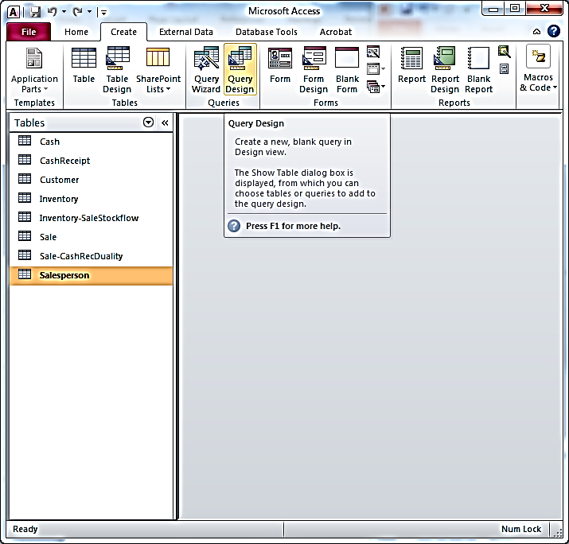
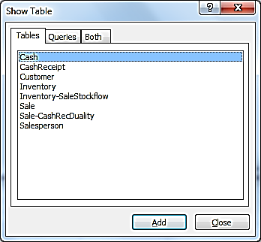
Relational Algebra SELECT in QBE
Cash Receipts from Customer C-2

Slide 55
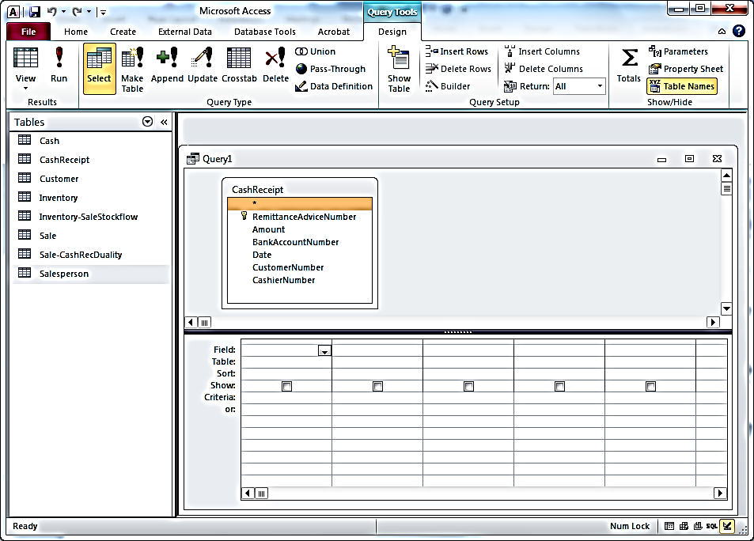
Relational Algebra “Select” QBE Example:
Cash Receipts from Customer C-2

Slide 56
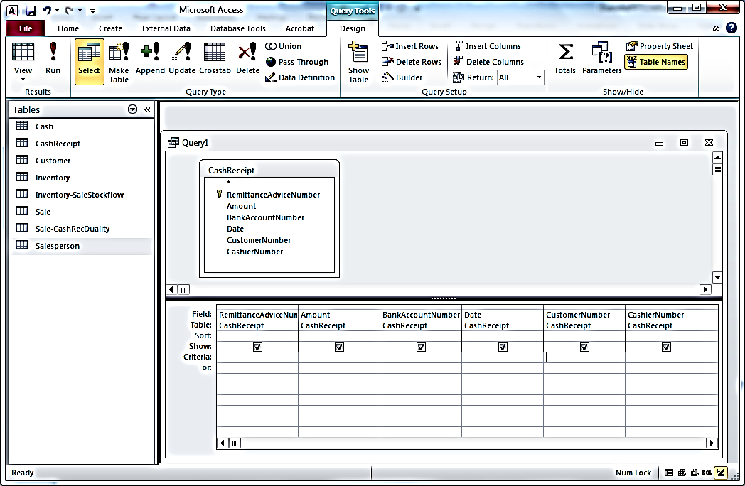
Relational Algebra SELECT in QBE
Cash Receipts from Customer C-2
Enter =“C-2” as Criteria in the Customer Number field

Slide 57

Relational Algebra SELECT in QBE
Cash Receipts from Customer C-2

Slide 58
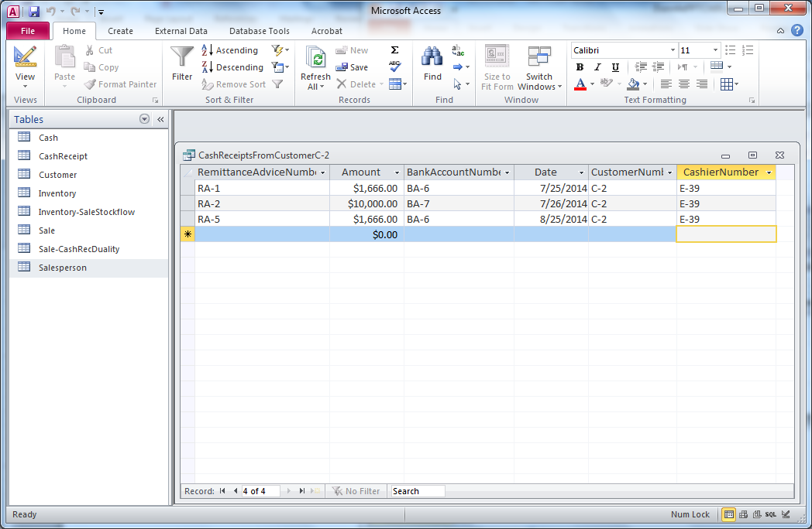
Result
Relational Algebra SELECT in QBE
Cash Receipts from Customer C-2

Slide 59
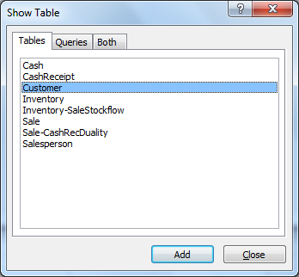
Relational Algebra PROJECT in QBE
Customer#, name, salesperson#

Slide 60
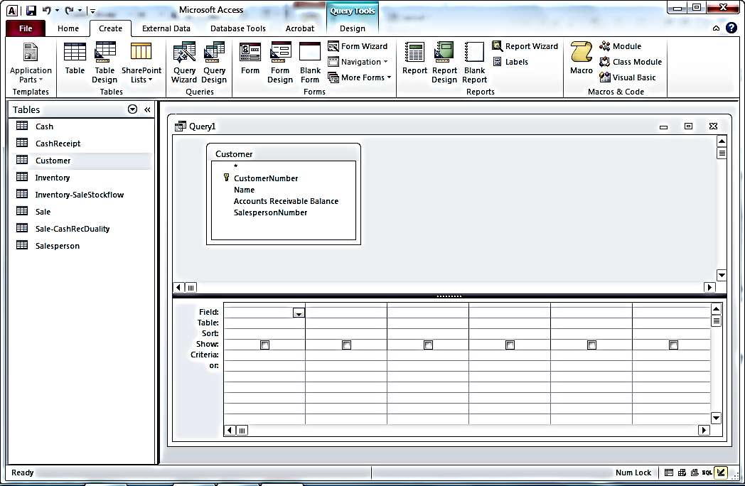
Relational Algebra PROJECT in QBE
Customer#, name, salesperson#

Slide 61
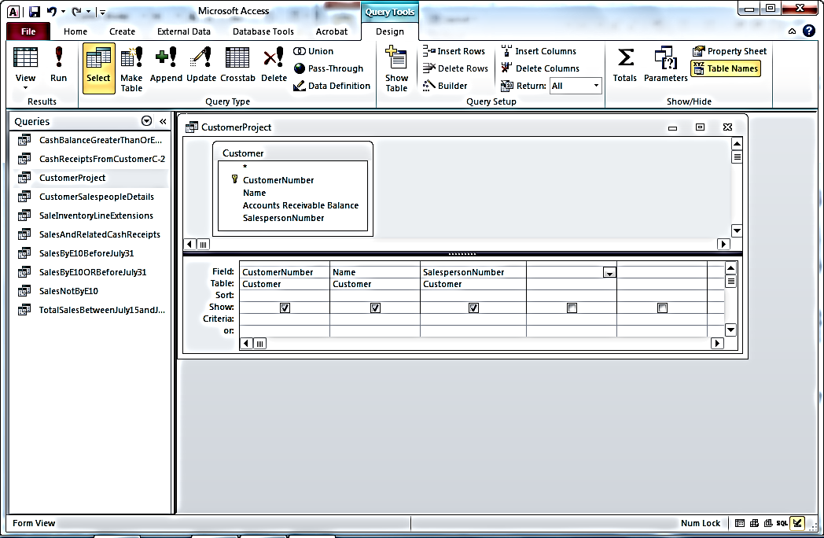
Relational Algebra PROJECT in QBE
Customer#, name, salesperson#

Slide 62
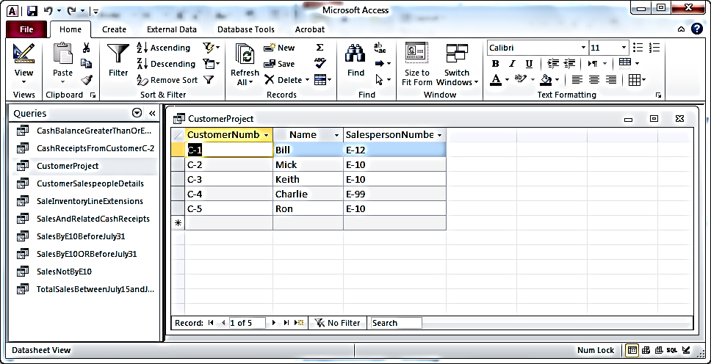
Relational Algebra PROJECT in QBE
Customer#, name, salesperson#
Result

Slide 63
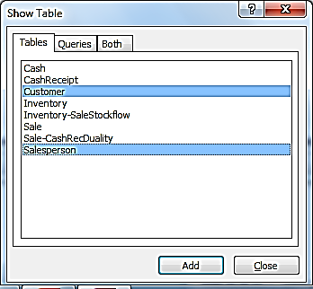
Relational Algebra Inner Join in QBE:
All details of customers and their salespeople

Slide 64
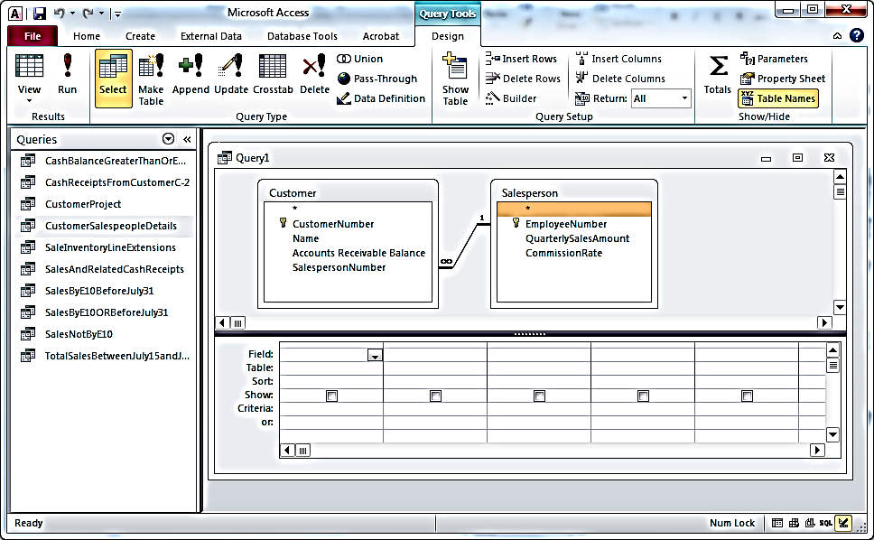
Relational Algebra Inner Join in QBE:
All details of customers and their salespeople

Slide 65
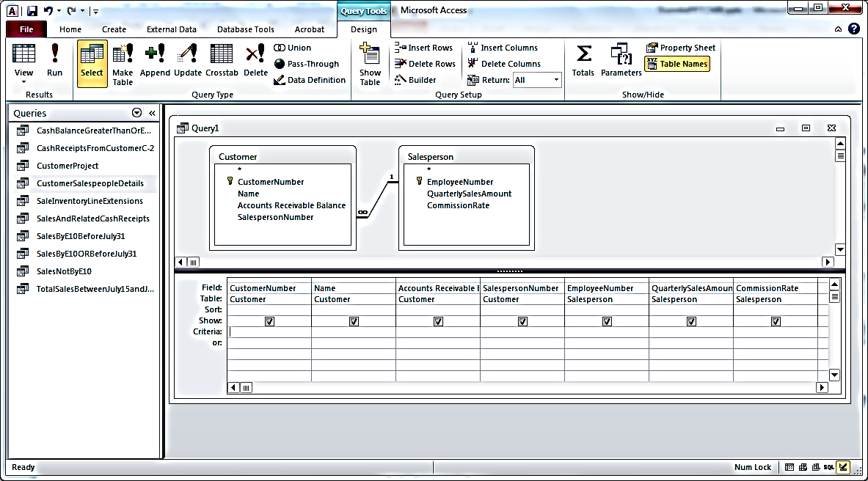
Relational Algebra Inner Join in QBE:
All details of customers and their salespeople

Slide 66
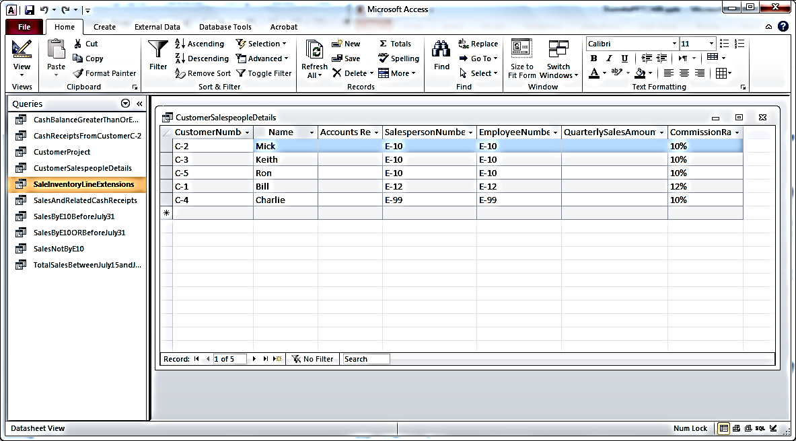
Relational Algebra Inner Join in QBE:
All details of customers and their salespeople
Result

Slide 67
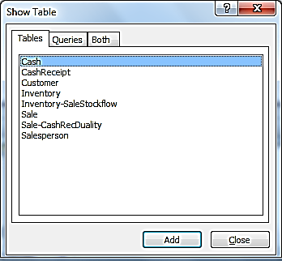
QBE with Mathematical Comparison Operator
Cash Account# and Balances >=$50,000

Slide 68
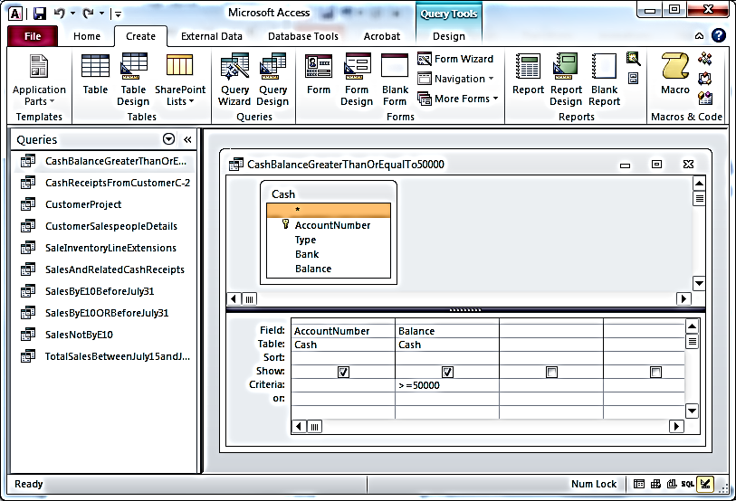
QBE with Mathematical Comparison Operator
Cash Account# and Balances >=$50,000

Slide 69
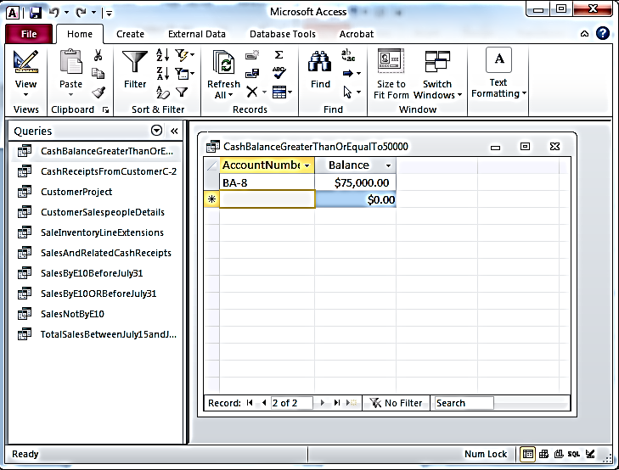
QBE with Mathematical Comparison Operator
Cash Account# and Balances >=$50,000
Result

Slide 70
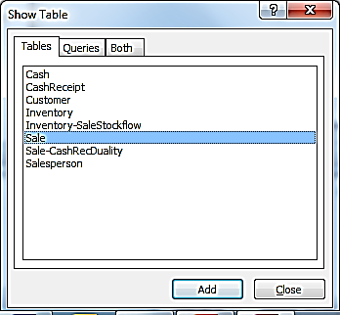
QBE with Mathematical Comparison on Character Attribute: Sales Not made by E-10

Slide 71
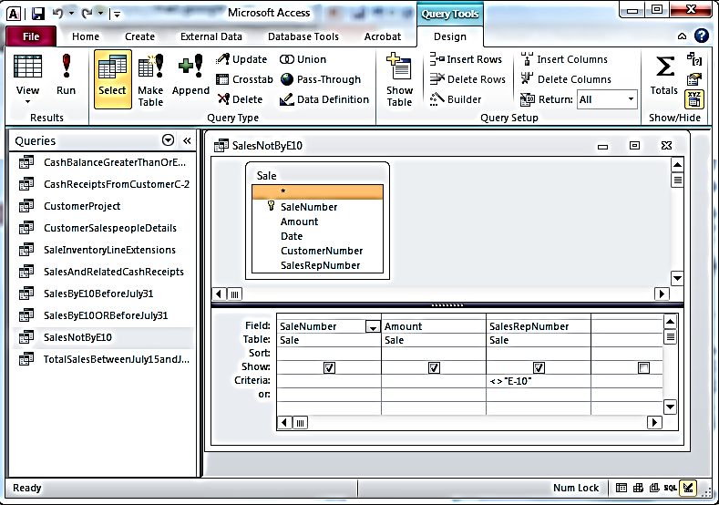
QBE with Mathematical Comparison on Character Attribute: Sales Not made by E-10

Slide 72
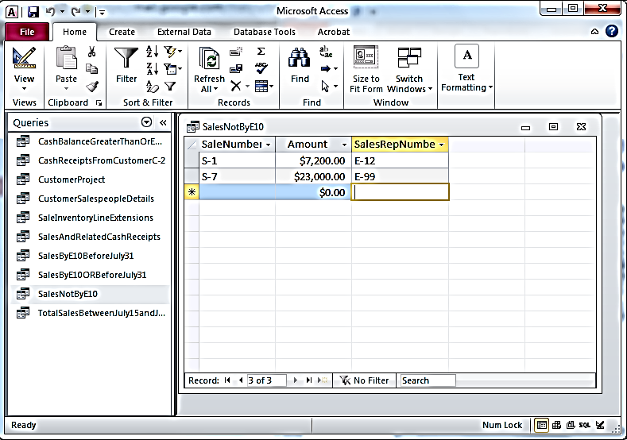
QBE with Mathematical Comparison on Character Attribute: Sales Not made by E-10
Result

Slide 73
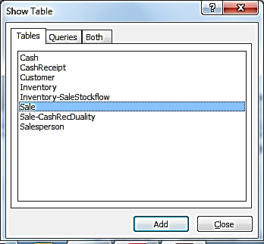
AND operator in QBE: Sales made before July 31 by Sales Rep E-10

Slide 74
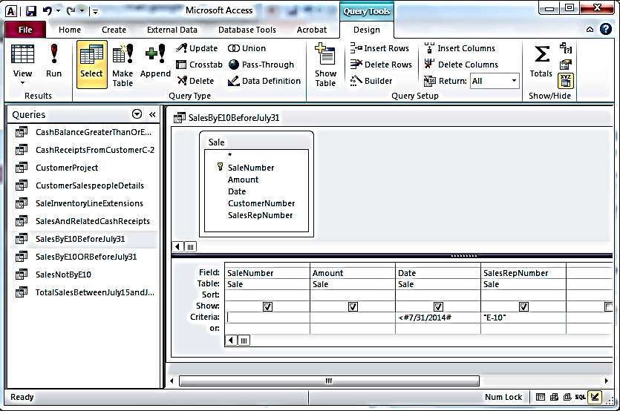
AND operator in QBE: Sales made before July 31 by Sales Rep E-10
Enter selection criteria on same line to accomplish logical “AND”

Slide 75
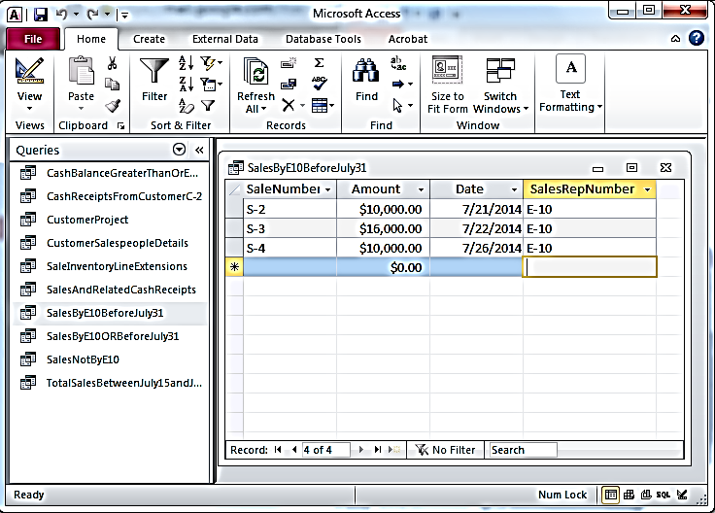
AND operator in QBE: Sales made before July 31 by Sales Rep E-10
Result

Slide 76
OR operator in QBE: Sales made before July 31 OR by Sales Rep E-10

Slide 77
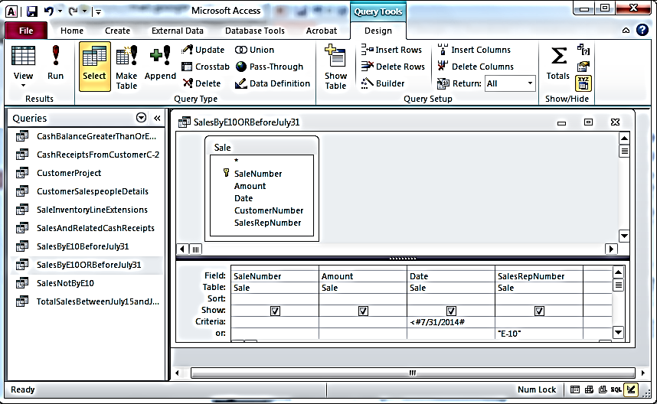
OR operator in QBE: Sales made
before July 31 OR by Sales Rep E-10
Enter selection criteria on separate lines to accomplish logical “OR”

Slide 78
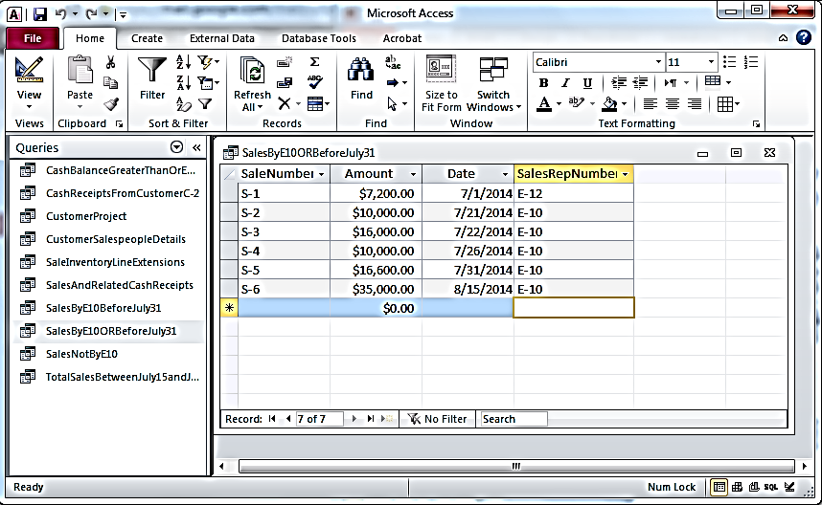
OR operator in QBE: Sales made before July 31 OR by Sales Rep E-10
Result

Slide 79
Aggregation SUM and Special Operator BETWEEN in QBE: Total Sales between July 15 and July 31

Slide 80
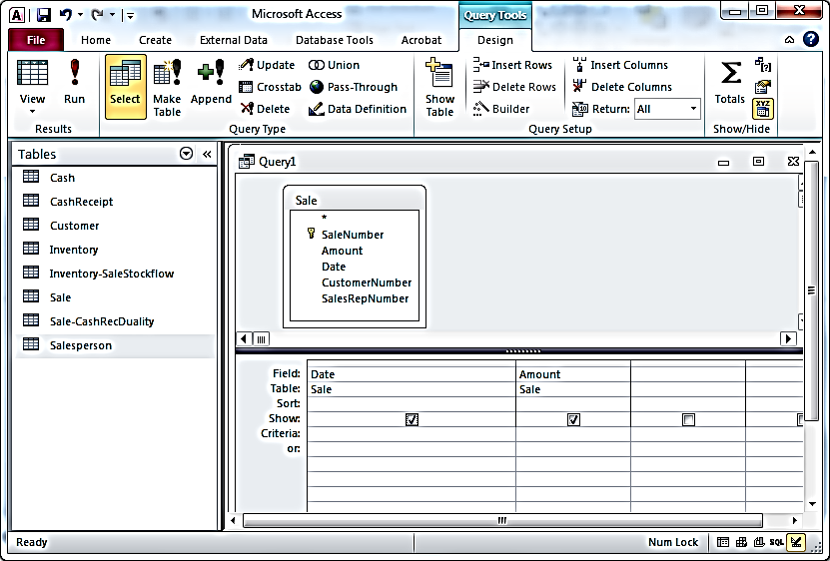
Aggregation SUM and Special Operator BETWEEN
in QBE: Total Sales between July 15 and July 31
Bring only the fields you need into the query grid

Slide 81
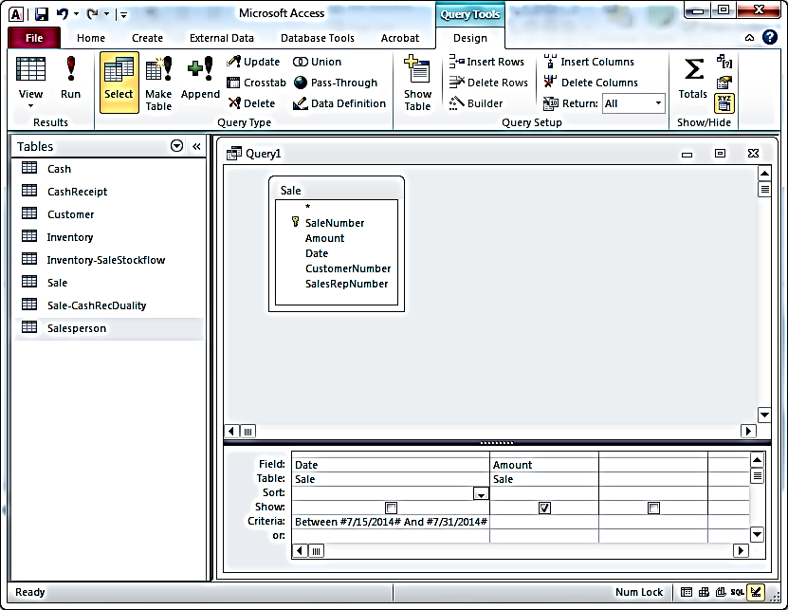
Aggregation SUM and Special Operator BETWEEN
in QBE: Total Sales between July 15 and July 31
Click on summation symbol to add “Total” line to query grid (used for aggregations)
Enter Criteria with BETWEEN operator

Slide 82
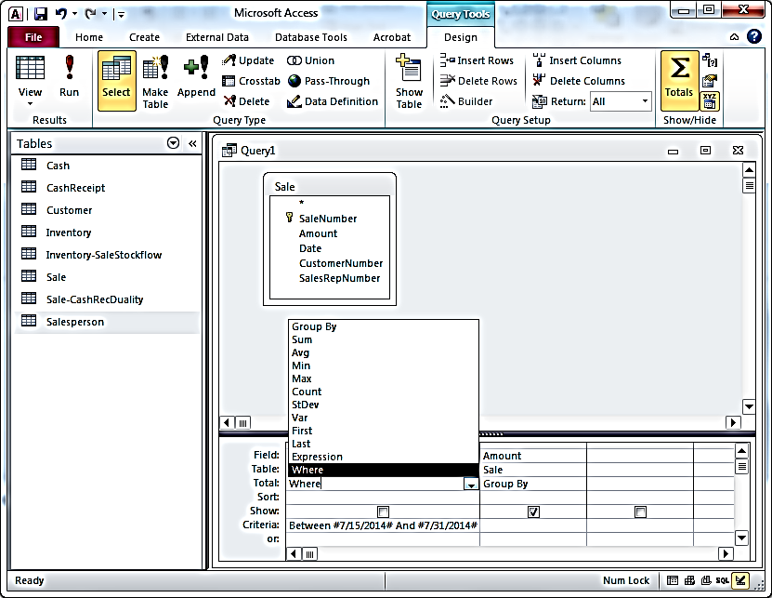
Aggregation SUM and Special Operator BETWEEN
in QBE: Total Sales between July 15 and July 31
Total line defaults to “Group By” for each field; Change the Amount field to “Sum” and change the Date field to “Where”

Slide 83
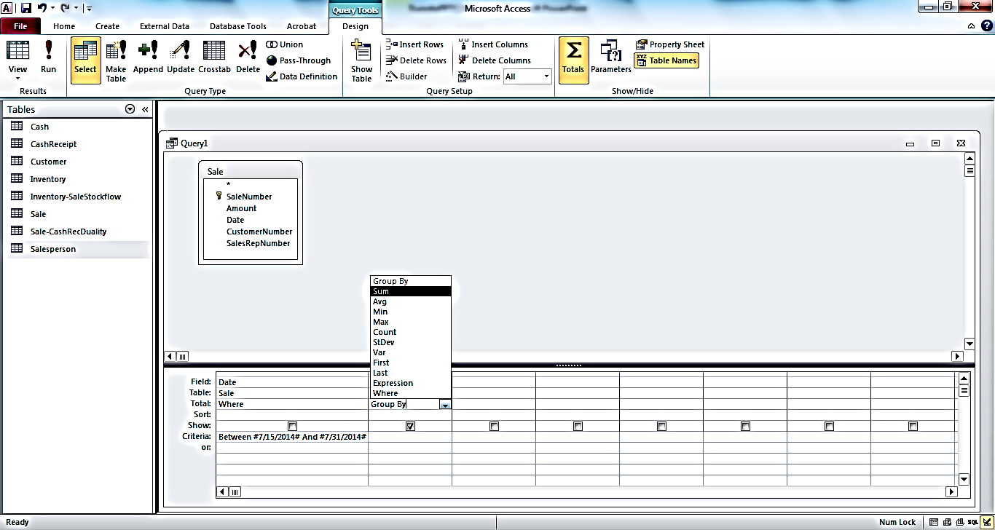
Aggregation SUM and Special Operator BETWEEN
in QBE: Total Sales between July 15 and July 31

Slide 84
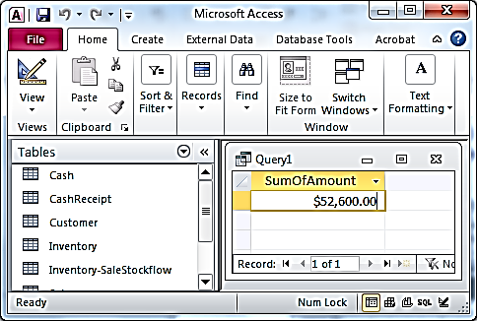
Aggregation SUM and Special Operator BETWEEN in QBE: Total Sales between July 15 and July 31
Result

Slide 85
Other questions related to an expanded RAE model

Slide 86
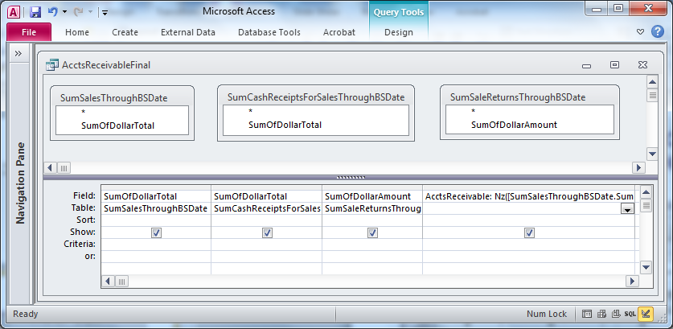
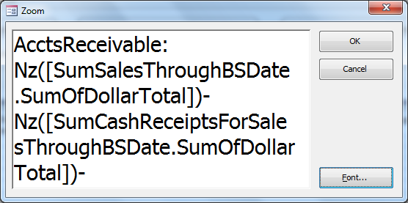
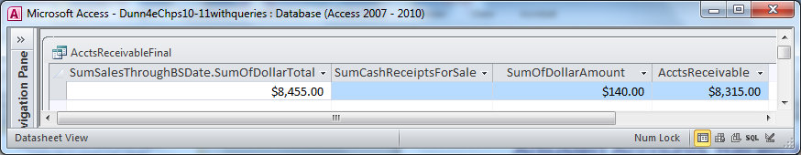
Adjusted Accounts Receivable Step 4 (using Nz to control null values)
Now it Works!!

Slide 87
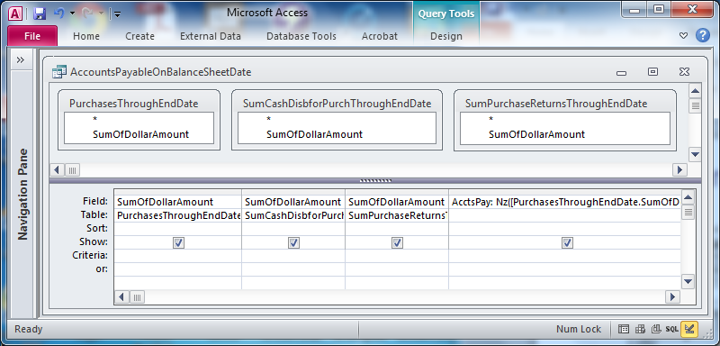
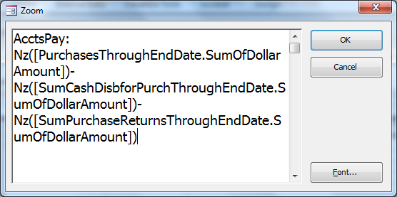
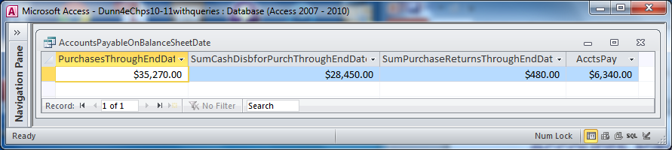
Accounts Payable Query Steps
Calculate Purchases – Cash Disb for Purchases – Purchase Returns

Slide 88
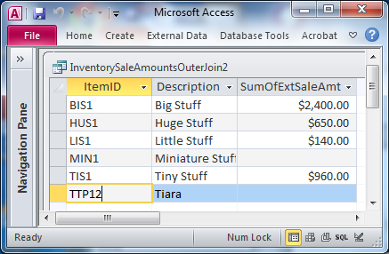
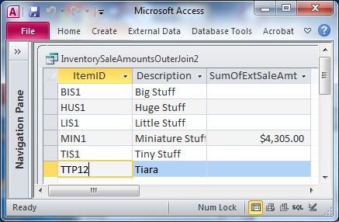
Query to identify highest and lowest selling inventory during a specific time period
Results for May 1-7, 2015 (could refine further with Max and Min on SumOfExtSaleAmt column if too many items to easily see highest is BIS1 and lowest is a tie between MIN1 and TTP12)
Results for May 8-14, 2015 (could refine further with Max and Min on SumOfExtSaleAmt column if too many items to easily see highest is MIN1 and lowest is a tie between all others)

Slide 89
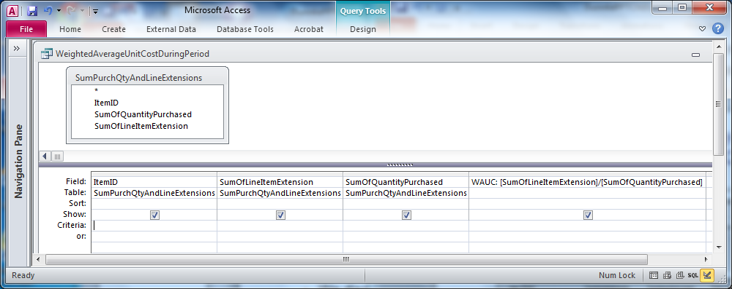

Querying for Inventory Weighted Average Unit Cost (not for Financial Statement use)
Divide total line item extensions by total purchase quantities for each item
Result for
May 1-31, 2015

Slide 90


Query to calculate number of days to fill selected sales orders
Step 2: Calculate average of days to fill orders
Result of Step 2

Slide 91

Query to identify inventory items with no positive customer reactions
Step 2: Outer join inventory type to positive reactions result; use “Is Null” operator to identify those without positive reactions.

Slide 92

Query for number of sales calls made by each salesperson during a time period
Result for May 1-15, 2015

